Slide 1
Network Intrusion Detection System Using Machine Learning
CAPSTONE PROJECT
Presented By:
Gundrasam Pavan Kumar Reddy Vellore institution of technology Amaravati Department: Computer Science and Engineering

Slide 2
OUTLINE
Problem Statement
Proposed System/Solution
System Development Approach
Algorithm & Deployment
Result
Conclusion
Future Scope
References

Slide 3
Problem Statement
Why NIDS matters:
• Modern networks face a barrage of sophisticated attacks—floods of traffic (DoS), stealthy probes, unauthorized logins (R2L), and privilege escalations (U2R)
• Existing signature-based tools struggle with novel or obfuscated threats
• We need an adaptive, data-driven system that spots anomalies in real time and classifies them accurately.

Slide 4
Proposed Solution
The proposed system aims to address the challenge of detecting malicious network activity and classifying it from normal network behavior. This supports the early identification of security threats, helping to protect networks from cyberattacks. The solution will include the following components:
Data Collection
Collect network traffic data with details such as protocol type, service, packet size, and connection duration.
Use labeled data indicating whether connections were normal or suspicious (anomalous).
Incorporate metadata about network sessions that might help reveal attack patterns.
Data Preprocessing
Clean and preprocess the collected data to handle missing values, inconsistencies, and irrelevant fields.
Apply encoding to categorical features such as protocol type and service names.
Perform feature engineering to create meaningful indicators (e.g., connection rates, error counts) that can improve detection accuracy.

Slide 5
Proposed Solution
Machine Learning Algorithm
Implement a machine learning algorithm, such as a Random Forest–based ensemble classifier, to distinguish between normal and abnormal traffic.
Use hyperparameter optimization and feature engineering to achieve the best performance.
Optionally, if detailed attack labels are available, extend the classification to categories such as DoS, Probe, R2L, and U2R.
Deployment
Deploy the trained model as a web service or API on IBM watsonx.ai to allow real-time predictions.
Provide a simple interface for cybersecurity teams to submit network session data and get immediate classification results.
Ensure the deployed system is scalable, secure, and integrates easily with existing network monitoring tools.

Slide 6
System Approach
The system aims to detect network intrusions in real time using machine learning. We start by analyzing a labeled dataset of network traffic and preprocessing it to clean and transform the data. Using IBM watsonx.ai, we train a Snap Random Forest Classifier with optimized features and parameters.
Once trained, the model is deployed as an API to classify incoming traffic as normal or anomalous. Real-time predictions help flag threats quickly, enabling proactive security actions. The system is scalable, accurate, and continuously improvable with new data—making it ideal for modern network defense.

Slide 7
Algorithm & Deployment
Algorithm Selection:
For this project, I selected the Snap Random Forest Classifier, a tree-based ensemble machine learning model. This algorithm was chosen because of its strong performance in classification tasks, particularly when dealing with complex, high-dimensional data like network traffic logs. Random Forests are also less prone to overfitting and can handle both numerical and categorical features, making them well-suited for detecting anomalies in varied connection patterns.
Data Input:
The model was trained on labeled network traffic data with features such as:
Duration of connection
Protocol type
Source and destination bytes
Connection flags
Count of connections to the same host/service and other flow-related attributes
These features capture both statistical and behavioral aspects of traffic, allowing the model to learn normal vs. abnormal activity patterns.

Slide 8
Algorithm & Deployment
Training Process:
The dataset was uploaded and preprocessed using watsonx.ai’s AutoAI, which automatically handled:
Feature selection and transformation
Data normalization
Class balancing
The AutoAI pipeline also performed hyperparameter optimization and cross-validation to ensure the best version of the Random Forest model was selected based on accuracy, F1-score, and ROC-AUC. The training was done using historical traffic data labeled as either "normal" or "anomaly."
Prediction Process:
Once deployed, the model uses live or batch input data to predict whether a given traffic flow is normal or potentially malicious. Inputs are passed as a structured JSON payload, and predictions are returned in real time via the model's REST API endpoint. This allows the system to be integrated into larger security frameworks for live threat detection and alerting.

Slide 9
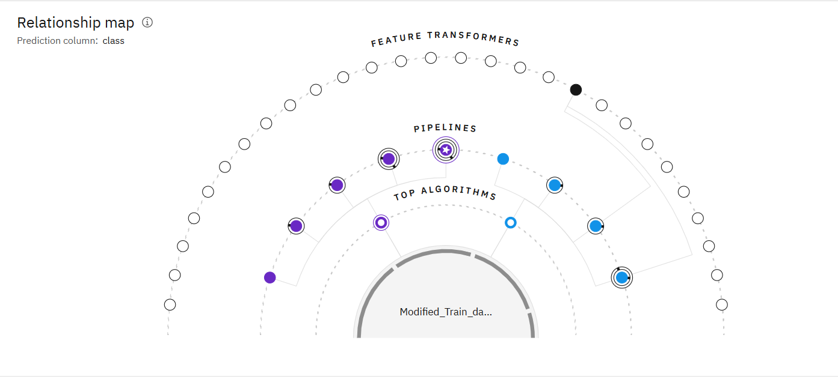
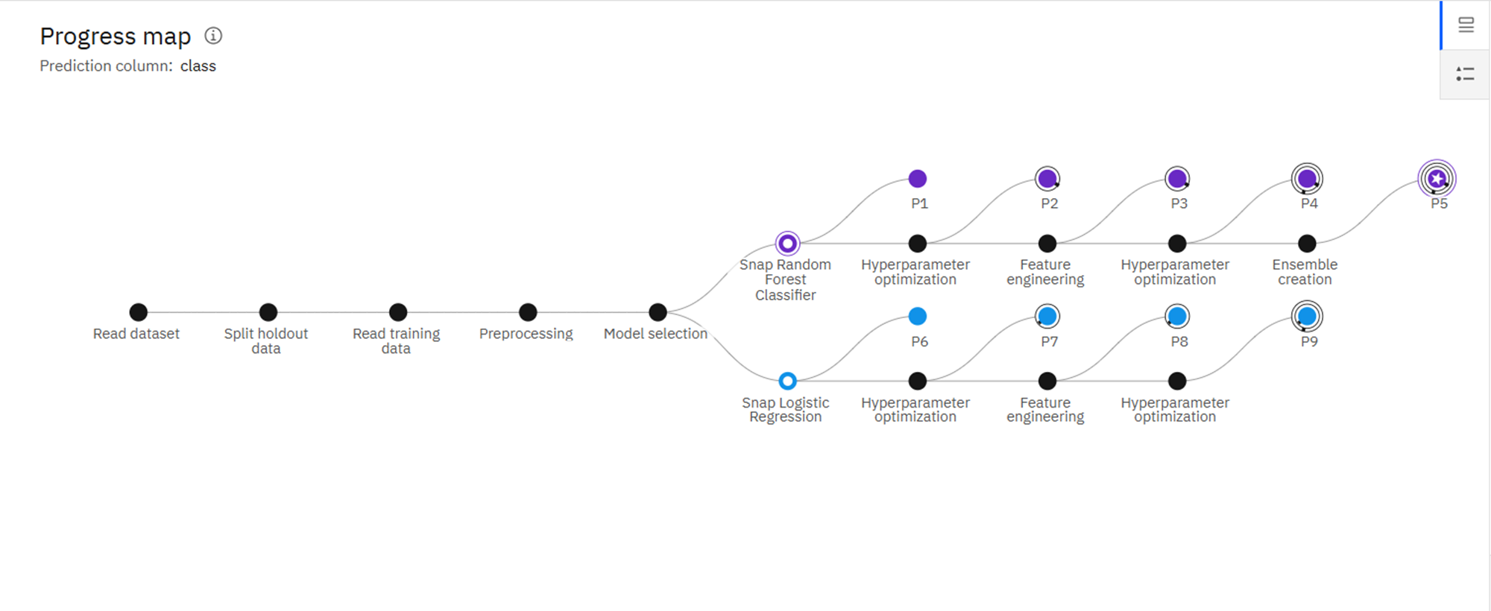
Result

Slide 10
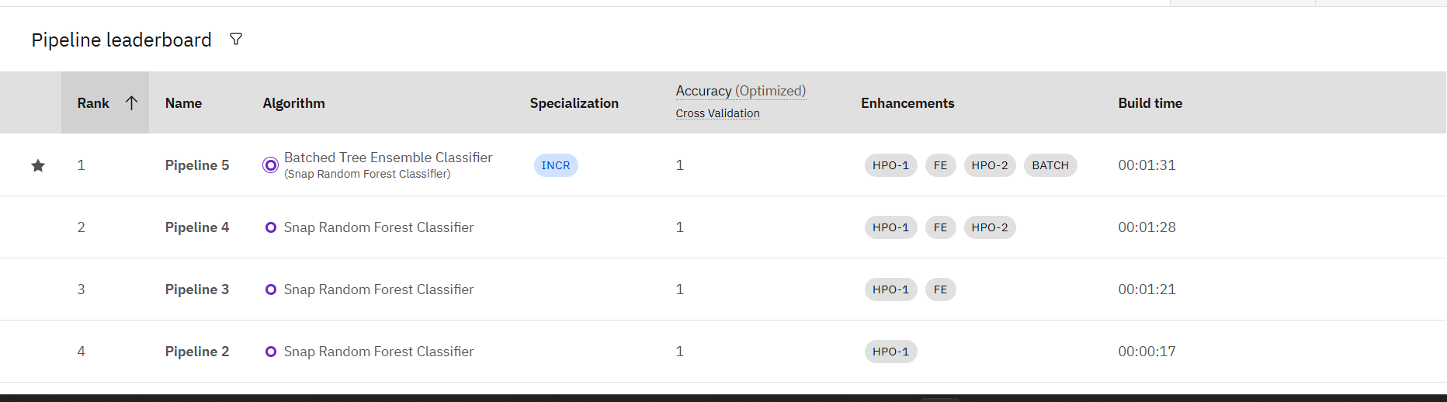
Result

Slide 11
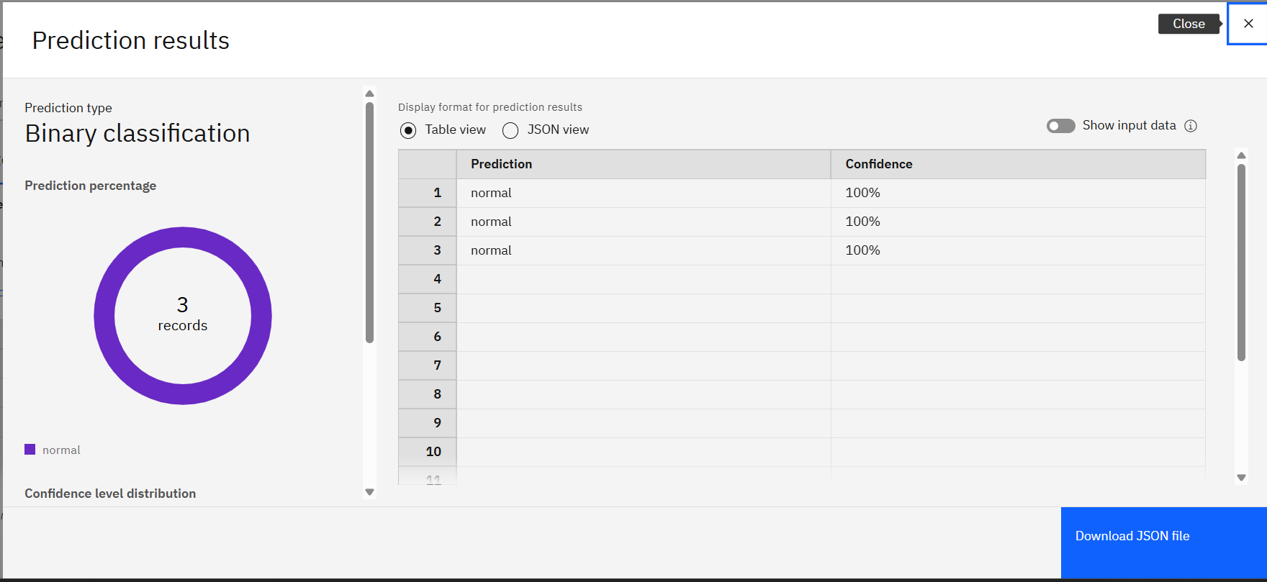
Result

Slide 12
Conclusion
Through this project, I was able to successfully build, train, and deploy a machine learning model using IBM Watsonx.ai on IBM Cloud. By leveraging the platform’s AutoAI and deployment features, I could automate much of the model-building process and generate a working API endpoint for real-time predictions.
This hands-on experience gave me deeper insights into how enterprise-grade AI workflows operate — from data preprocessing to model evaluation and deployment. With the model now live, I can integrate it into real-world applications and continue refining it with more data or feedback.
This project not only improved my technical skills in cloud-based AI but also gave me a clear picture of how AI solutions can be practically implemented to solve real-world problems.

Slide 13
Future scope
This project marks just the beginning of what’s possible with AI on the cloud. Going forward, the model can be improved and expanded in the following ways:
Data Enrichment: Incorporate more diverse and real-time data sources to improve prediction accuracy and model generalization.
Model Optimization: Explore advanced algorithms or fine-tune hyperparameters for better performance.
Interactive Interface: Build a simple web or mobile app that uses the deployed API to deliver predictions in real time to end users.
Continuous Learning: Implement feedback loops where the model learns from new data over time, making it smarter and more adaptive.
Scalability: Deploy the model to serve more users simultaneously using load balancing and other scalable cloud infrastructure options.
By extending and refining this project, it can evolve into a robust, production-ready AI solution tailored to specific business or social needs.

Slide 14
References
IBM Watsonx.ai https://www.ibm.com/cloud/watsonx-ai
IBM Cloud Machine Learning REST API Reference. https://cloud.ibm.com/apidocs/machine-learning
IBM Developer Guide: Authenticating to IBM Cloud. https://cloud.ibm.com/docs/cloud-foundry?topic=cloud-foundry-using-credentials
Scikit-learn: Machine Learning in Python. https://scikit-learn.org/
Kaggle Dataset Repository. https://www.kaggle.com/

Slide 15
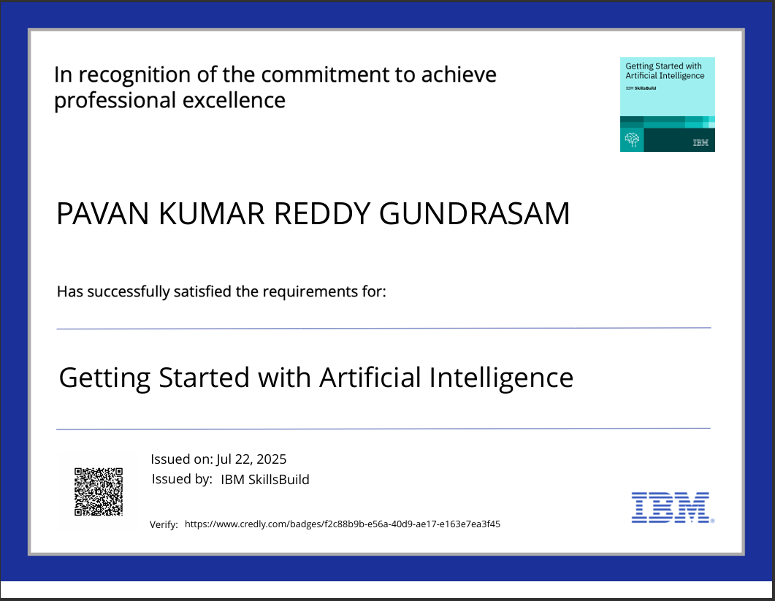
IBM Certifications

Slide 16
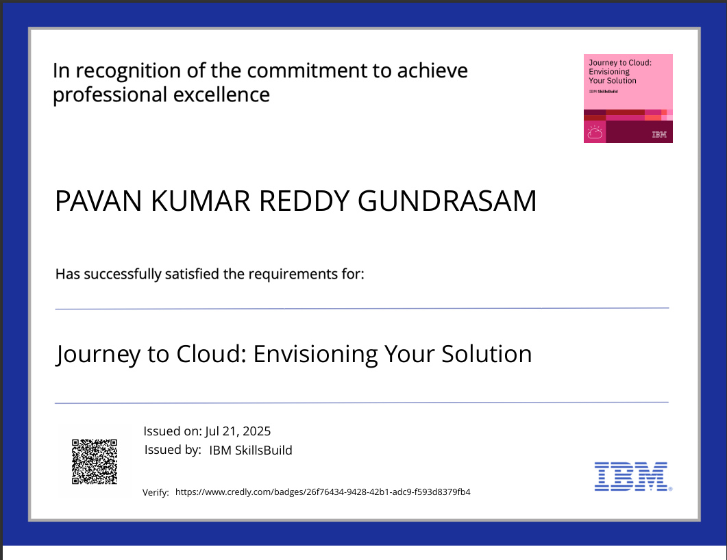
IBM Certifications

Slide 17
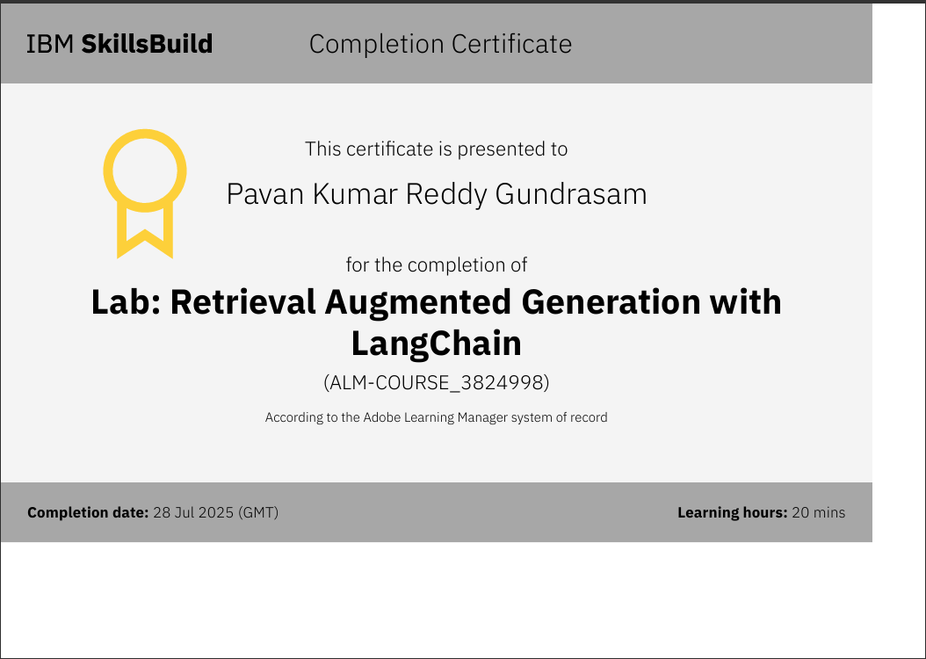
IBM Certifications

Slide 18
THANK YOU

